Slide 1
20241113 LP-P2 C1 PTC OOS

Slide 2
Discipline 1. 選定團隊 Form the Team
團隊負責人Team Leader/Dept.:
成員Team Member/Dept.:
Name | Department | Position

Slide 3
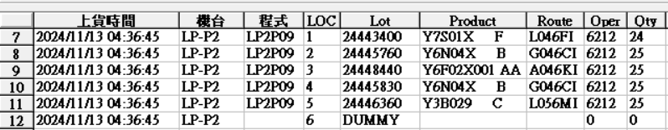
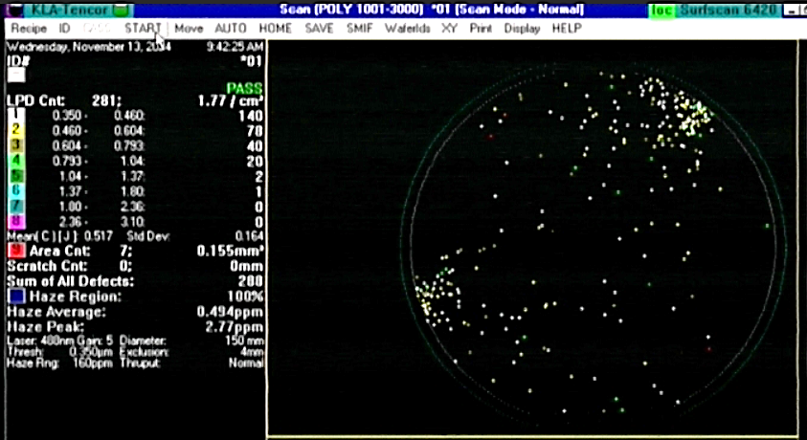
Discipline 2.描述問題及現況掌握Describe the Problem
(WHO detected the problem? WHAT is wrong? State the problem in terms of object and defect. WHERE the problem was first detected, describe location of the detection, lot #, WHEN and HOW it was detected)
What | Route : as table Product : Lot number : Qty: 5lot/125pcs
Where | LP-P2
When | 2024/11/13
Extent | LP-P2 run P09 C1 PTC = 271 OOS, map分佈 1點鐘、8點鐘邊緣 Product for AOI check

Slide 4
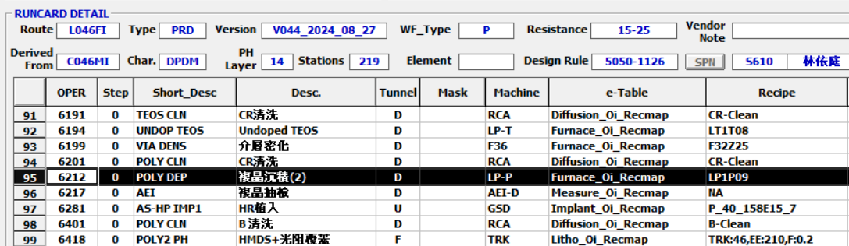
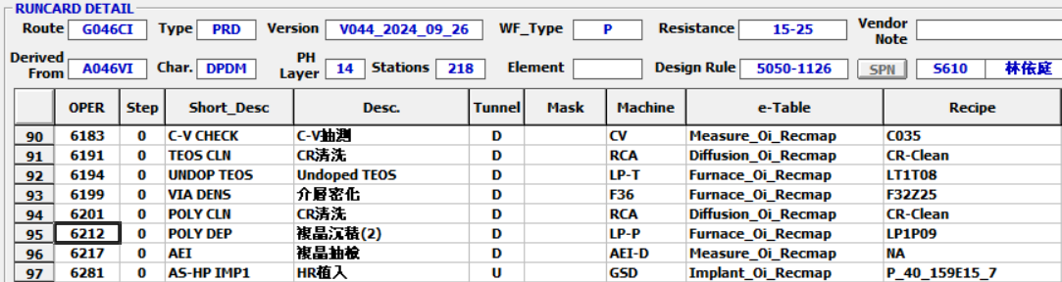
Runcard
L046FIG046CI/L046KI/L056MI OP.6212 < HR POLY>

Slide 5
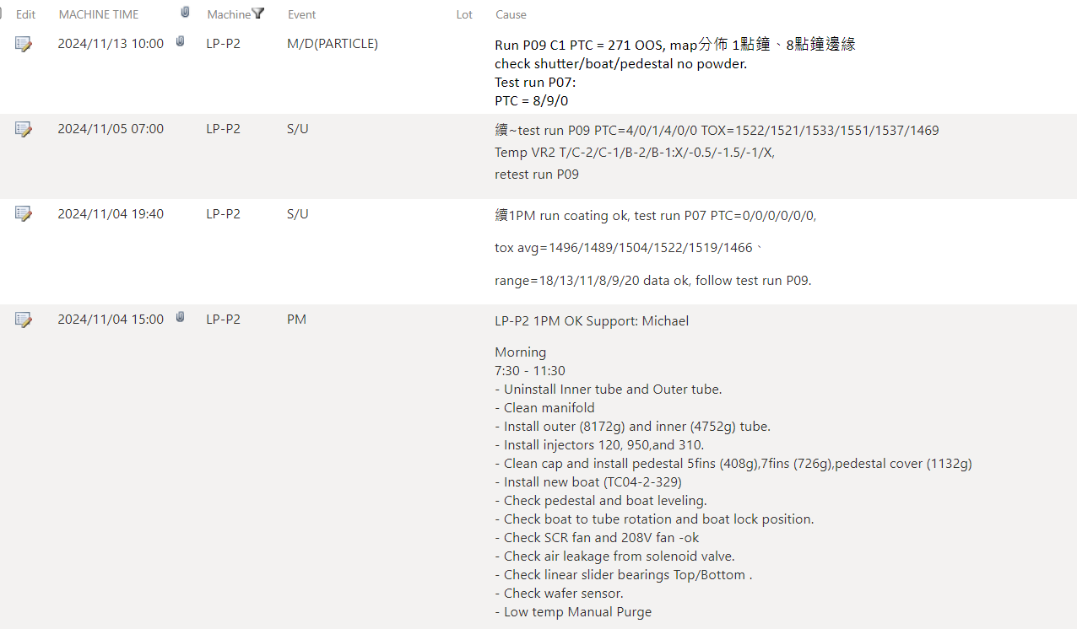
Discipline 2.描述問題及現況掌握Describe the Problem
lot History - 調查過程簡述 (Investigation):
LP-P2 MD record
11/4 BPM
11/13 C1 PTC=271 (spec<60) OOS , MW with 1,8am pattern issue
EQ check hardware shutter/boat/pedestal all normal , re-test P09 C1/C4/C6 ptc=8/9/0 normal.

Slide 6
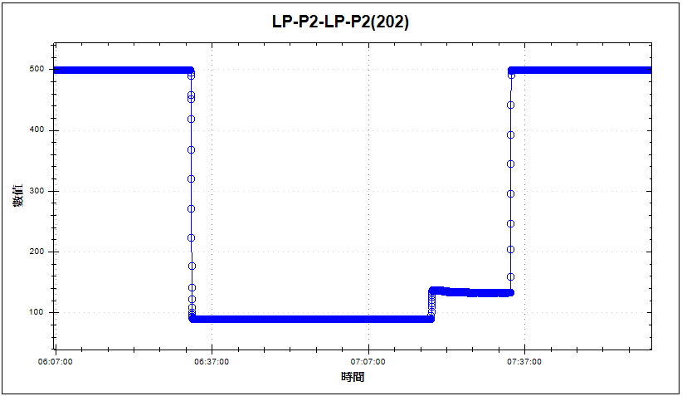
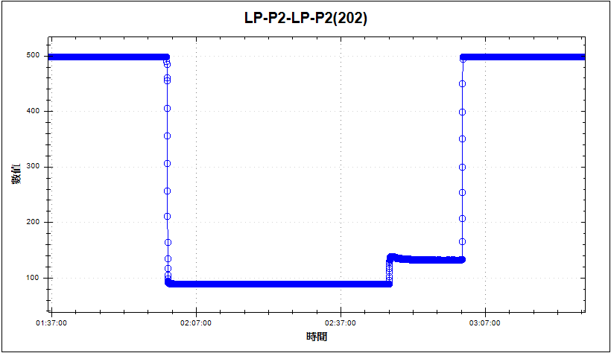
Discipline 3. Contain the Problem 緊急對策:對於解決D2的行動,包含清庫存等
APC check：
Check issue run，step.14 反應步驟 APC 131~135 stable
比較前一 run，step.14 反應步驟 APC 131~135 stable，比對結果無差異
D1
D2
D3
Issue run Step.14 APC stable
D4
D5
D6
前一 run Step.14 APC stable
D7
D8

Slide 7
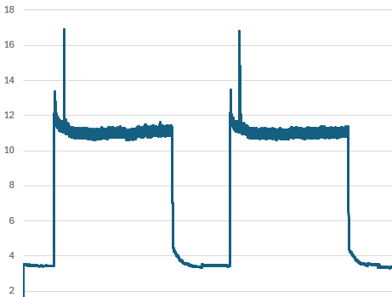
Discipline 3. Contain the Problem 緊急對策:對於解決D2的行動,包含清庫存等
D1
Pump 電流 check：
Issue run & 前一 run Pump 電流 10.6~11.3(A)，比對結果無差異
D2
Pump down 瞬間
D3
D4
D5
D6
前一 run
Issue run
D7
D8

Slide 8
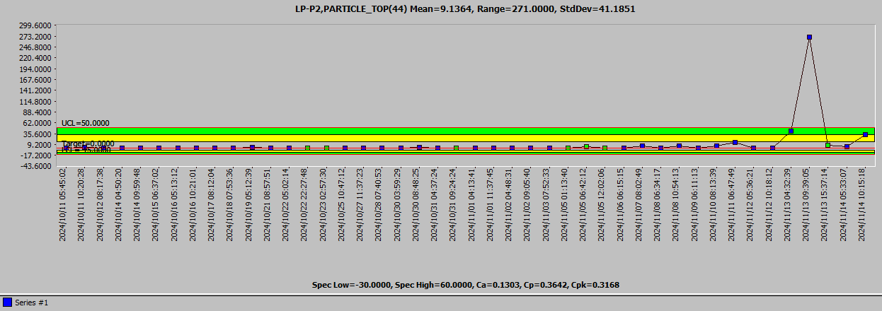
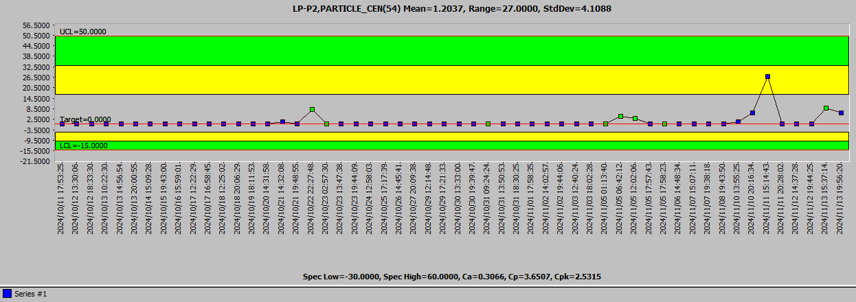
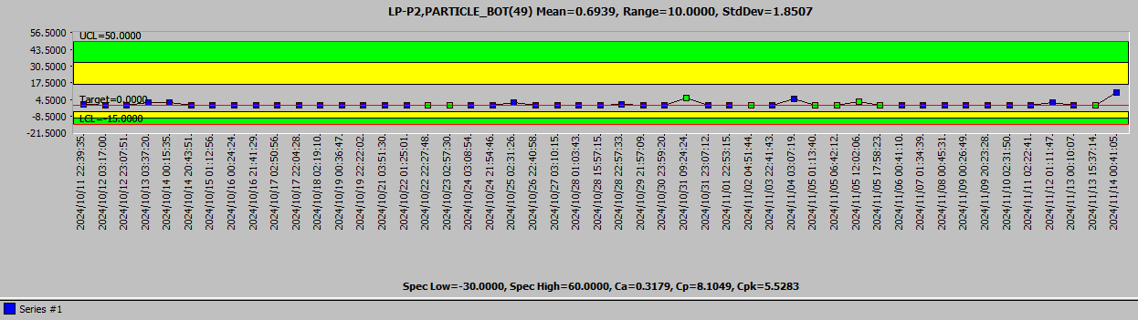
Discipline 2.描述問題及現況掌握Describe the Problem
lot History - 調查過程簡述 (Investigation):
2. LP-P2 particle check
10/11~ 11/13 C1/C4/C6 particle trend normal
11/13 particle up test run ptc =8/9/0 <60 , release LP-P2
C1 test run
C4 test run
C6 test run

Slide 9
Discipline 2.描述問題及現況掌握Describe the Problem
lot History - 調查過程簡述 (Investigation):
3. LP-P2 product check
LP-P2 MW C1 PTC=271 OOS
Check :
加洗 D-CLEAN 後 MW ptc C1=289 OOS , 產品 C1/C4 加掃 AOI 10X check
C1 – 24443400 AOI 10X_ 6217 (0.31% ~ 1%)
C4 – 24445830 AOI 10X_ 6217 (2.86% ~ 7.65%) , OM check poly small defect issue
結論 : C1 PTC OOS 疑 MW 控片 issue確 , 比對 C1 產品之AOI MAP 無 1,8點鍾 特殊 pattern Action : C4-24445830 FH OP. 6433 Poly 蝕刻後 AOI check

Slide 10
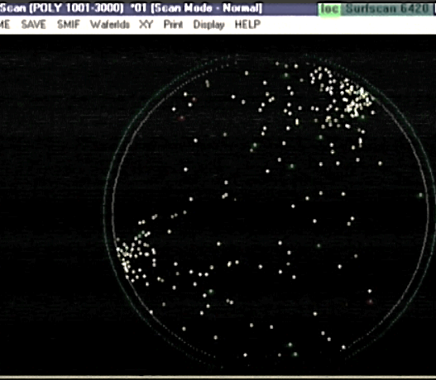
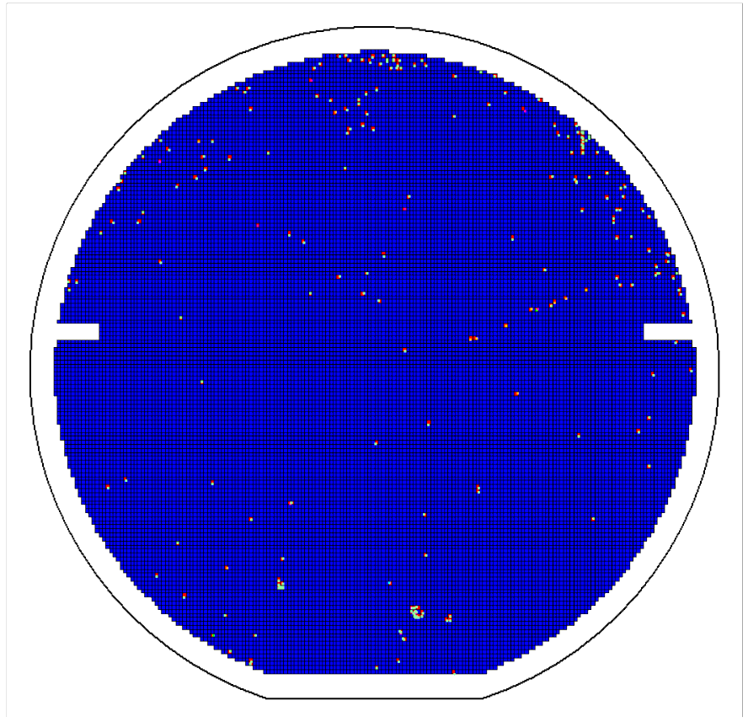
Discipline 2.描述問題及現況掌握Describe the Problem
MW C1 : 1,8 點鍾 異常 pattern
產品 C1 : 1,8 點鍾 正常

Slide 11
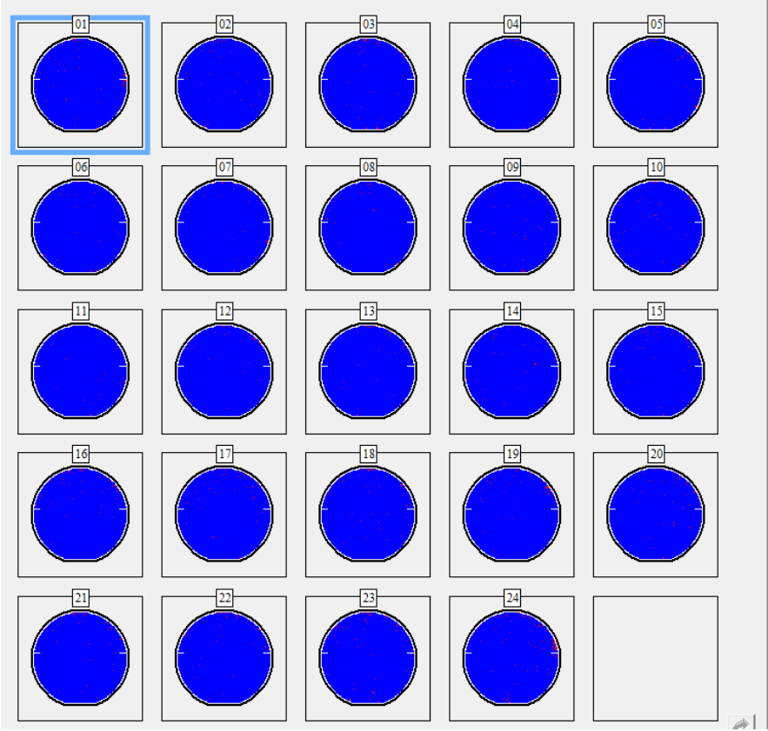
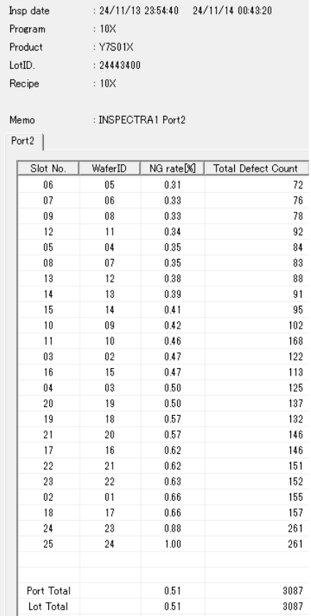
C1 : 6217 (0.31% ~ 1%)
AOI MAP 無 1,8點鍾 pattern

Slide 12
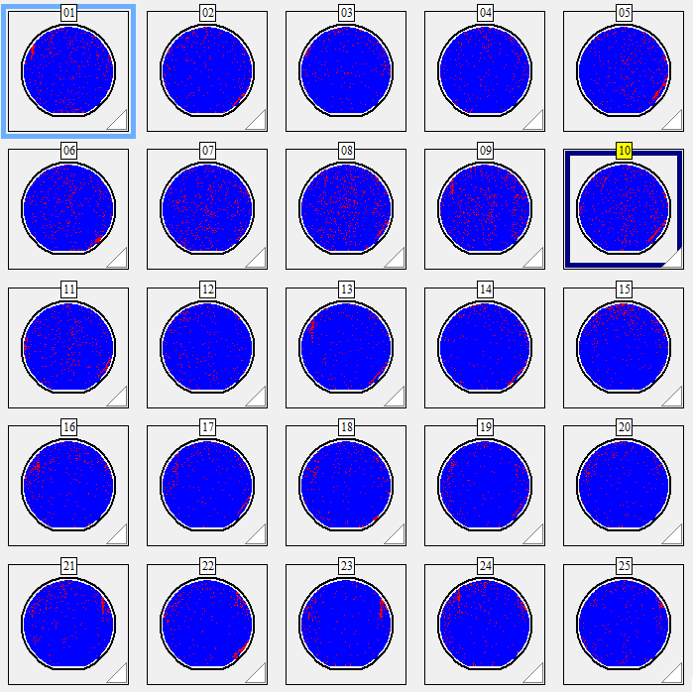
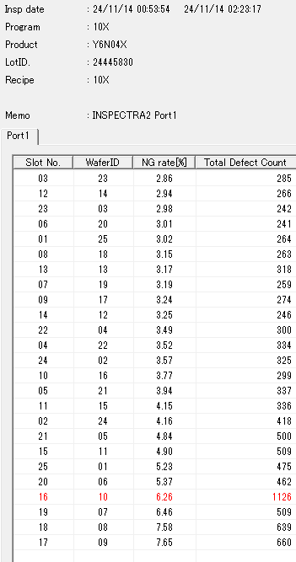
C4 : 6217 (2.86% ~ 7.65%)
G046CI-Y6N04X-24445830-6217_op
AOI scan defect rate: 2.86~7.65%
OM check #9 by small defect issue

Slide 13
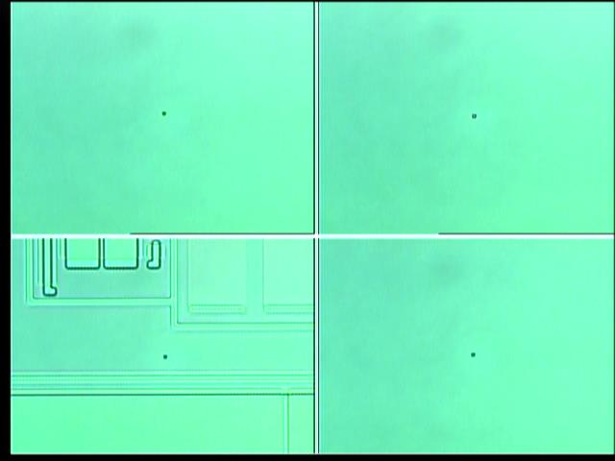
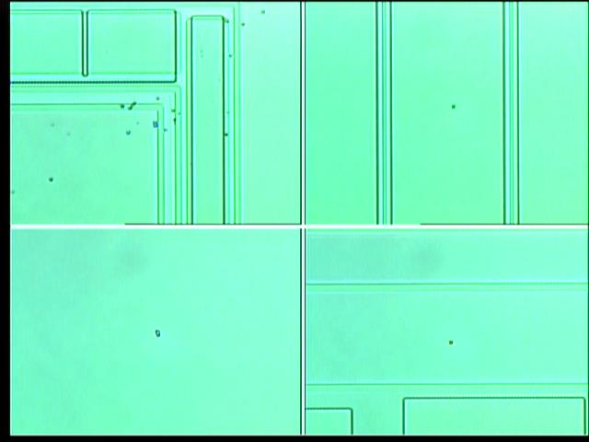
#9
#9

Slide 14
Summary
11/13 LP-P2 run P09 MW C1 PTC=271 OOS , map分佈 1點鐘、8點鐘邊緣
EQ check hardware shutter/boat/pedestal all normal , re-test P09 C1/C4/C6 ptc=8/9/0 normal.
ALL 加洗 D-CLEAN 後 MW ptc C1=289 OOS , 產品 C1/C4 加掃 AOI 10X check :
C1 – 24443400 AOI 10X_ 6217 (0.31% ~ 1%)
C4 – 24445830 AOI 10X_ 6217 (2.86% ~ 7.65%) , OM check poly small defect issue
結論 : C1 PTC OOS 疑 MW 控片 issue確 , 比對 C1 產品之AOI MAP 無 1,8點鍾 特殊 pattern
Action : C4 產品 24445830 設定 FH OP. 6433 <Poly 蝕刻> 後 re-check AOI

Slide 15
Discipline 2.描述問題及現況掌握Describe the Problem
Is/Is Not table (釐清問題):
 |  | Is | Is Not
What | object
 | Defect
Where | Location
 | Machine
When | First time
 | Reoccurred
How | Many
 | Trend

Slide 16
Discipline 3.執行及驗證暫時防堵對策 Contain the Problem
(Define and implement containment actions to isolate the effect of problem from any internal/external customer until corrective action is implemented)
3.1 異常產品 (Defect Lots)
項目 Item | 處理方式 Action | 負責人員 Resp | 預定完成日 Due | 實際完成日 Imp. | 處理結果 Verification

Slide 17
Discipline 3.執行及驗證暫時防堵對策 Contain the Problem
(Define and implement containment actions to isolate the effect of problem from any internal/external customer until corrective action is implemented)
3.2 波及產品 (Impact Lots)
項目 Item | 處理方式 Action | 負責人員 Resp | 預定完成日 Due | 實際完成日 Imp. | 處理結果 Verification

Slide 18
Discipline 3.執行及驗證暫時防堵對策 Contain the Problem
(Define and implement containment actions to isolate the effect of problem from any internal/external customer until corrective action is implemented)
3.3 波及設備 (Impact Machine)
項目 Item | 處理方式 Action | 負責人員 Resp | 預定完成日 Due | 實際完成日 Imp. | 處理結果 Verification
3.4 波及製程 (Impact Route) : 是(YES)/否(No)
項目 Item | 處理方式 Action | 負責人員 Resp | 預定完成日 Due | 實際完成日 Imp. | 處理結果 Verification
3.5 產品召回選項，是否需進行客戶端波及產品的召回?是(YES)/否(No)
Customer | Product No. | Lot number / Wafer number | Approx. Quantity

Slide 19
Discipline 4.定義及驗證真因 (Identify the Root Cause)
(Identify all potential causes which could explain why the problem occurred)
4.1 Non-conformance root cause (defect nature / technical root cause):
a) Failure mechanism:

Slide 20
Discipline 4.定義及驗證真因 (Identify the Root Cause)
(Identify all potential causes which could explain why the problem occurred)
4.1 Non-conformance root cause (defect nature / technical root cause):
b) 列出所有可能的原因 (Probable Causes/Factors): Non-conformance
工具 (Tools): 故障樹分析 (Fault Tree Analysis)、魚骨圖 (Fishbone)

Slide 21
Discipline 4.定義及驗證真因 (Identify the Root Cause)
(Identify all potential causes which could explain why the problem occurred)
4.1 Non-conformance root cause (defect nature / technical root cause):
c) 真因驗證 (Root Cause Verification)

Slide 22
Discipline 4.定義及驗證真因 (Identify the Root Cause)
(Identify all potential causes which could explain why the problem occurred)
4.1 Non-conformance root cause (defect nature / technical root cause):
d) 5-Why analysis
b) Conclusion :

Slide 23
Discipline 4.定義及驗證真因 (Identify the Root Cause)
(Identify all potential causes which could explain why the problem occurred)
4.2 Non-detection / escape root cause (Provide reason to why the current system failed to detect)
a) 5-why:
b) Conclusion

Slide 24
Discipline 5.擬定及驗證永久改善對策Choose and verify permanent corrective action (列出各項執行之對策並檢核其對策有效性)
5.1 What was the chosen corrective action to correct the root cause? (Add photo or diagram where applicable.)

Slide 25
Discipline 5.擬定及驗證永久改善對策Choose and verify permanent corrective action (列出各項執行之對策並檢核其對策有效性)
5.2 Verification of actions effectiveness

Slide 26
Discipline 6.實施認永久改善對策Corrective Actions Implementation
6.1 For non-conformance root cause (defect nature / technical root cause):
Nbr. | Actions | Who | When | Remarks / Evidence (Document/Spec/Chart #)
6.2 For non-detection / escape root cause
Nbr. | Actions | Who | When | Remarks / Evidence (Document/Spec/Chart #)

Slide 27
Discipline 7.避免再發Prevent Recurrence (Modify System / Document)
7.1 Systemic Actions:
Factor | Actions | Who | When | Remarks / Evidence (Document/Spec/Chart #)
Practices/ Training
Work Instruction
Specification
Control Plan
* FMEA (must)
Error Proofing

Slide 28
Discipline 7.避免再發Prevent Recurrence (Modify System / Document)
FMEA new item:
Item | Potential Failure Mode | Potential Effect(s) of Failure | S. E. V. | C L A S S. | Potential cause(s) / mechanism(s) of Failure | O. C. C. | Current Process Control Prevention | Current Process Controls Detection | D. E. T. | R. P. N. | Recommended Action | Responsibility & Target Completion Date | Action Results
Process, Function, Requirements |  |  |  |  |  |  |  |  |  |  |  |  | Actions Taken | S. E. V. | O. C. C. | D. E. T. | R. P. N.

Slide 29
Discipline 7.避免再發Prevent Recurrence (Modify System / Document)
7.2 Corrective Actions Fan-out: (水平展開):
Machine/ Process/ Product | Actions | Responsible | Due date

Slide 30
Discipline 8. Congratulate the Team
Thanks for every member helped in this case.
Reviewed and Approved by:
Name | 2. Position | 3. Date

